Slide 1

Dr. B. C. Roy Engineering College , Durgapur
EXAM INVIGILATION ALLOCATION SYSTEM
PROJECT GROUP 6
Department of Information Technology
Semester : Eighth
Session : 2015-2019
Mentor: Prof. Prabal kumar Sahu
GROUP MEMBERS
AKASH KUMAR (12000215005)
NIKHITA SRIVASTAVA (12000215027)
RITESH KUMAR VERMA (12000215037)
SAMRAT NISHANT (12000215043)

Slide 2
Contents :
Introduction
Existing System
Objectives
User Requirements Specification
Tools and Technology Used
Study of the System
Administrator
Administrator Module
Faculty
Faculty Module
Student
Functional Requirements
Tools and Technology Used
Screenshots
Future Scope
Conclusion

Slide 3
INTRODUCTION
This project is developed for the college, to simplify examination hall allotment and seating arrangement manual work.
It facilitates to access the examination information of a particular student in a particular class.
The purpose of developing this seating arrangement system is to provide a way to allocate exam hall for each student without any clash.
This project also allocate particular invigilator for particular hall.
It is also very useful for the college where the software may generate the hall separation and concerned reports.

Slide 4
Existing System
Existing system is very slow and inefficient. Report generation is also not an easy task in the current situation.
There is a lot of manual work involved in current system and mistake in one detail can lead to wrong generation of page.
No proper collection of requirements leads a huge problem for this system.
This system is to enhance manual work and also more energy is wasted to allocate the seating arrangement.
Not User Friendly.
Student always find problem in finding their rooms allocated before the exam.

Slide 5
OBJECTIVES
To computerize the traditional way of assigning seats in exams.
To generate the seating arrangement automatically.
To relieve both students and exams coordinators from stressful search for names and seat at notice board and pasting of seat allocation all around on the various exams centers.
To prevent exams malpractices, since student’s seats will be generated randomly irrespective of the course or department of the student.

Slide 6
USER REQUIREMENTS SPECIFICATION
The user (exams officers) are able to enter and generate the seat allocation.
The main specification outlines by the user is to be able to make sure that a student is not surrounded by a colleague who is writing the same paper since this will prevent malpractices.
The user also seeks that, if the exams hall contains students writing the same paper, the system should be able to generate double even numbers in other to give spacing between students to prevent malpractice.
The system should also be able to generate set of numbers for a particular department if the exams hall contains different departmental students. Example: to generate seat number 1 to 20 for IT students writing information systems, seat number 21 to 40 for biomedical students writing medical imaging.

Slide 7


TOOLS AND TECHNOLOGY USED
Xampp
XAMPP is a free and open-source cross-platform
web server solution stack package developed
by Apache Friends, consisting mainly of the
Apache HTTP Server, MariaDB database, and
interpreters for scripts written in the PHP and
Perl programming languages.
PHP
PHP: Hypertext Preprocessor
(or simply PHP) is a
server-side scripting language designed
for Web development, and also used as a
general-purpose programming language.
It was originally created by Rasmus Lerdorf in 1994

Slide 8



Contn.
HTML ( Hypertext Markup Language )
Hypertext Markup Language (HTML) is the
standard markup language for creating web
pages and web applications.
CSS (Cascading Style Sheets)
It is a style sheet language used for
describing the presentation of a document
written in a markup language like HTML.
Javascript
JavaScript enables interactive web pages and thus is
an essential part of web applications. All major
web browsers have a dedicated JavaScript
engine to execute it.

Slide 9
STUDY OF THE SYSTEM MODULES: This system has been divided or broken into modules in other to explain the block functionalities of the system. The modules involved are:
Administrator
Faculty
Student

Slide 10
ADMINISTRATOR
The administrator is the main controller or manager of this system. Only admin have access into this admin page with detailed login information. The administrator has all the information about all the student and faculty. This module is divided into different sub-modules which he manages.
Student
Faculty
Department
Course
5. Hall
6. Student Seat Allocator
7. Faculty Duty Allocator

Slide 11
ADMINISTRATOR MODULE
The admin can perform the following activities using the system.
MANAGE HALL
MANAGE DEPARTMENT
STUDENT HALL
ALLOCATOR
MANAGE COURSE
ADMIN
SESSION LOGOUT
BULK DATA ENTRY
MANAGE STUDENT & FACULTY
FACULTY ALLOCATOR

Slide 12
2 FACULTY
1. The faculty has the opportunity to perform the following activities at the faculty page.
2. The faculty can login onto and logout the system using username and password and can view the allocated hall for exam using its faculty ID.
The faculty has the privilege to view profile and update its own profile.
3. The faculty has the privilege to delete and edit from any category of under the faculty ID
4. Inside the faculty module is other sub-models which are:
View Allocated Hall
Faculty (sub modules: edit profile, change password, logout)

Slide 13
FACULTY MODULE
The Faculty can perform the following activities using the system.
VIEW ALLOCATED DUTY
EDIT PROFILE
FACULTY
CHANGE CREDENTIALS
SESSION LOGOUT

Slide 14
3 STUDENT
The student has the opportunity to perform the following activities at the Student page :
1. The student can login onto and logout the system using username and password and can view the allocated hall for exam using the select option.
The student has the privilege to view and update profile.
2. The student has the privilege to delete and edit from any category of under the student ID submodule which can enable the student to edit profile, change password.
3. Inside the student module is other sub-models which are:
View Seat Plan
Student ID (sub modules: edit profile, change password, logout)
.

Slide 15
STUDENT MODULE
The Student can perform the following activities using the system.
EDIT PROFILE
VIEW ALLOCATED HALL
STUDENT
CHANGE
CREDENTIALS
SESSION
LOGOUT

Slide 16
FUNCTIONAL REQUIREMENTS
The functional requirements of the system simply told is that the system delivered in order to meet user’s requirement as mentioned in the user specification.
i. Check examination hall
ii. Check hall details
Print exams duty slip before exams.
NON-FUNCTIONAL REQUIREMENT
All other to do task that are not present in the functional requirements will be considered as the non-functional requirement

Slide 17
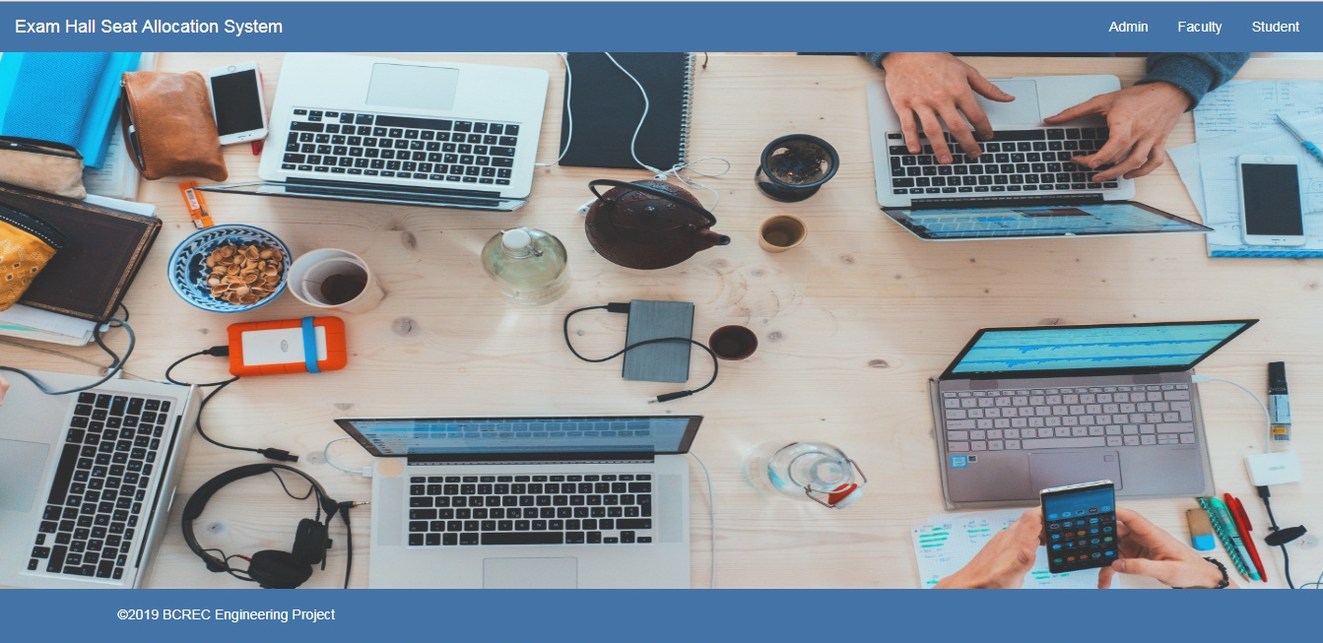
SCREENSHOTS Home Screen

Slide 18
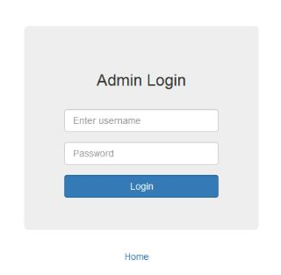
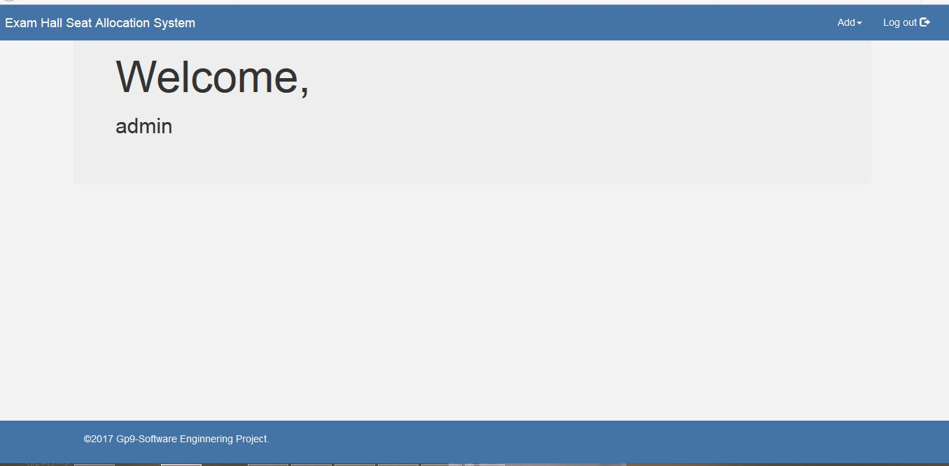
Admin login using the credentials will be redirected to the Admin Home Page

Slide 19
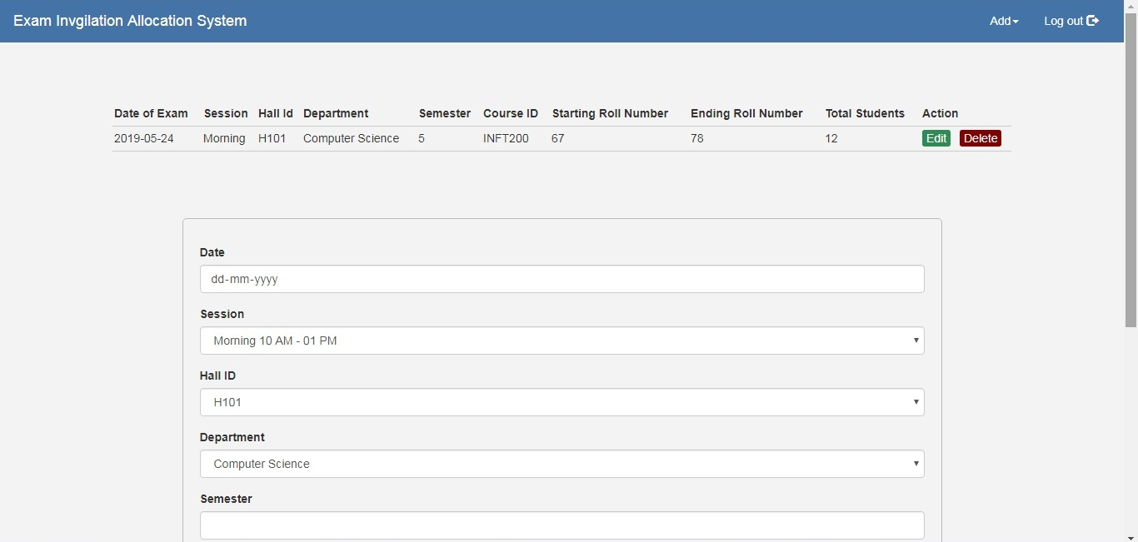
student hall Allocation

Slide 20
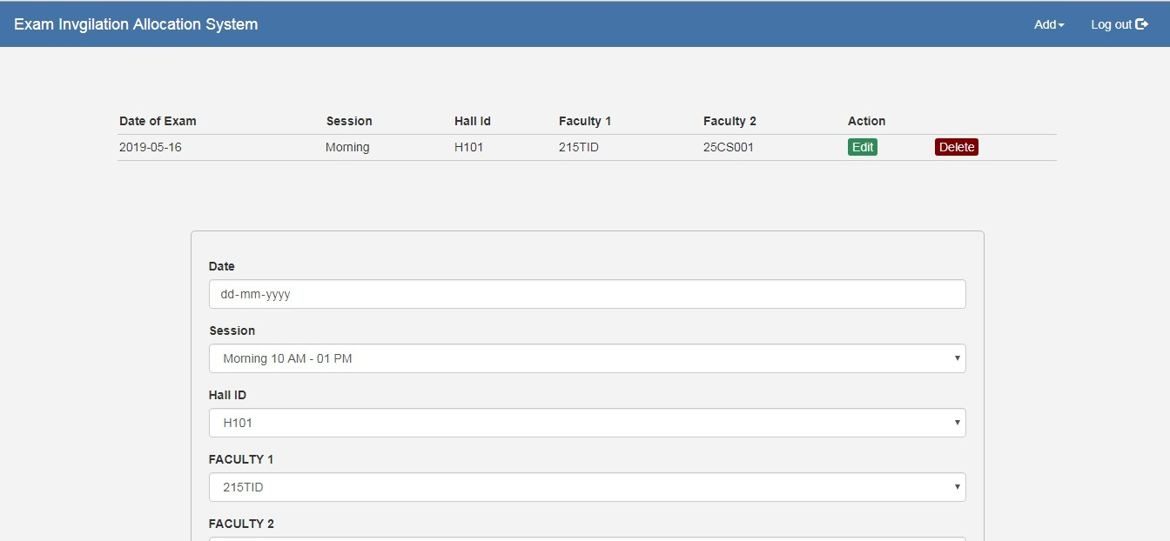
faculty Duty Allocator

Slide 21
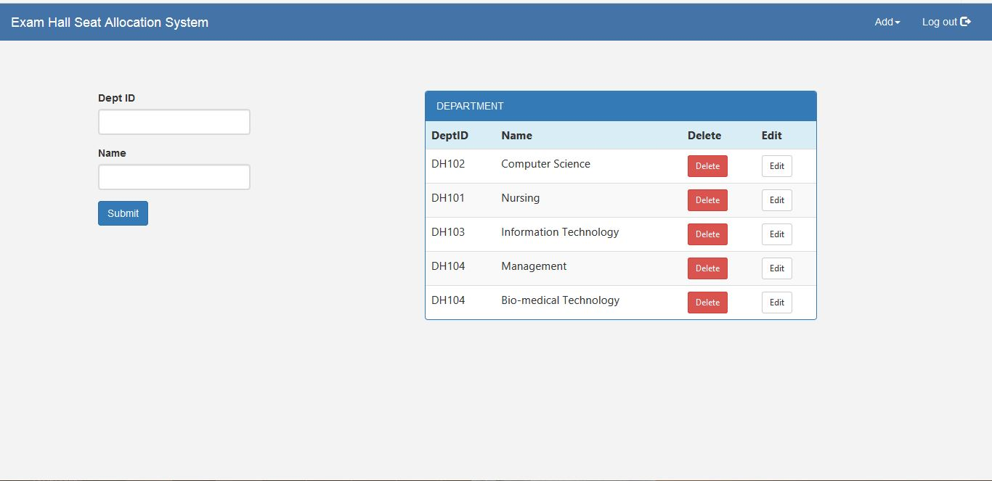
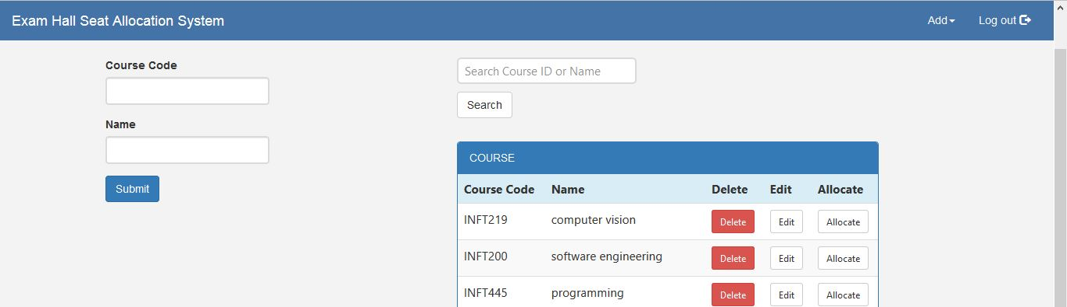
Department Course

Slide 22
Future Scope
The existing system can be enhanced, by storing the hall ticket into a database, instead of a file so that the statistics about the hall ticket obtained can be easily analyzed.
We can implement this system with much more functionality in near future where admin can handle several CCTV installed in each exam hall during the exams using grid views .
Students and Faculty can get Alerts before each exam day regarding their Allocated Seat and Allocated Duty in respective halls .using SMS integrations and many more functionalities can be embedded in this system as and when required .

Slide 23
CONCLUSION
The system was designed in such a way that future modifications can be done easily. The following conclusions can be deduced from the development of the project.
Automation of the entire system improves the efficiency.
It provides a friendly graphical user interface which proves to be best.
It gives appropriate access to the authorized users
depending on their permissions.
It effectively overcomes the delay in communications.
Updating of information becomes so easier.
A web based interface for showing hall name for student is developed, which makes students to see their seat in respective hall, easily. A web based interface for analyzing the student academic details are developed. Username and password is created for unique user by register their details in register module. And they can change it by the permission of administrator only.

Slide 24


